Slide 1

Understanding the Linux Operating System Foundations for Embedded Linux
Embedded Linux System Programming 2025-1S
Juan-Bernardo Gómez-Mendoza
Universidad Nacional de Colombia Sede Manizales
April 11, 2025

Slide 2
Outline
Part I: Introduction to Linux and System Abstractions
I-B: Abstraction Layers in Linux Programming
Open Q&A
Part II: Linux Filesystem Organization & Philosophy
II-B: CLI Exploration and Filesystem Hands-On
II-C: Practical Views into System Internals
Recap & Open Q&A

Slide 3

Part I Introduction to Linux and System Abstractions

Slide 4
What is Linux
A Unix-like, open-source kernel created in 1991 by Linus Torvalds
Widely used in servers, supercomputers, mobile (Android), and embedded systems
Not an OS by itself — it’s the kernel
Supported by a global community and thousands of contributors

Slide 5
GNU/Linux
Linux is the kernel — it handles process scheduling, memory management, and hardware abstraction.
GNU (GNU’s Not Unix) provides userland tools — the shell, compilers, libraries, and essential utilities (e.g., bash, gcc, coreutils).
A complete and usable operating system requires both: GNU/Linux.
This distinction is particularly important when working at the system level, such as in embedded development.
Example: Debian, Ubuntu, Arch, and Yocto-based distributions all use the Linux kernel, but differ in how they integrate GNU tools, package software, and manage system configuration.

Slide 6
What is an Operating System
An Operating System (OS) is software that manages hardware resources and provides essential services for applications.
It serves as an intermediary between user programs and physical hardware components.
The OS abstracts hardware complexity by exposing a consistent and standardized interface to software developers.
Typical OS services include process scheduling, memory allocation, device access, file system management, and user/session control.
In embedded systems, the OS must often balance performance, footprint, and real-time constraints, influencing whether to use full Linux, stripped-down distros, or a real-time OS (RTOS).

Slide 7
Major OS Components
The operating system is composed of various modules and layers:
Kernel: The core that runs in privileged mode, managing CPU, memory, and I/O.
System Libraries: Provide standardized interfaces to kernel services (libc, libm, etc.).
Shell: Command-line interface for user interaction (bash, sh, zsh).
System Utilities: Programs for managing the system (top, ps, ifconfig, mount, etc.).
Embedded Linux systems may include only a subset of these components for efficiency.

Slide 8
Linux Architecture Overview
Linux separates the system into User Space and Kernel Space.
User Space:
Applications
Command-line tolos
Libraries (like libc)
Kernel Space:
Scheduler, memory manager, network stack
Virtual file system (VFS)
Device drivers and interprocess communication mechanisms

Slide 9
Why is Linux Key in Embedded Systems?
Configurability: The kernel can be trimmed for size or tuned for performance.
Hardware Support: Extensive driver support for a variety of SoCs and peripherals.
Ecosystem: Build systems (e.g., Yocto, Buildroot) and debugging tools (e.g., GDB, strace).
Licensing: Open-source and GPL-licensed, reducing cost and vendor lock-in.
Real-Time Capabilities: Support for real-time patches (e.g., PREEMPT_RT) for deterministic response.
Community and Longevity: Backed by an enormous global developer base and over 30 years of maturity.

Slide 10

Part I-B Abstraction Layers in Embedded Linux Programming

Slide 11
Abstraction Layers in Embedded Linux
In Linux-based embedded systems, development can happen at various levels of abstraction, depending on the design goals and hardware integration.
These levels include:
System-Level: Interfacing directly with the hardware (BSPs, device trees, kernel modules).
Backend Services: Managing runtime behavior and data processing (systemd, daemons, middleware).
Frontend Interfaces: Communicating with the user (local HMIs, web dashboards).
This separation helps:
Simplify team collaboration
Reduce system complexity
Improve testability and modularity

Slide 12
System-Level: Role and Scope
Concerned with hardware enablement and low-level configuration.
Common tasks:
Preparing the Board Support Package (BSP): includes kernel config, drivers, bootloader config.
Editing Device Tree Blobs (DTBs) to declare SoC peripherals (memory, I2C, SPI, etc.).
Writing and loading Kernel Modules (LKM) to interface with custom hardware.
Typically requires privileged access, and changes often involve kernel recompilation or rootfs updates.

Slide 13
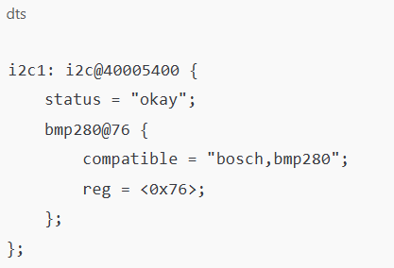
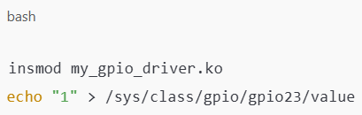
System-Level Example: DT + Driver

Slide 14
Backend Services: Role and Scope
Focused on managing system state, background operations, and services.
Components at this layer:
Init system: systemd, sysvinit, busybox init handle service startup.
Useful for running sensor data collectors, managing network services, and triggering automated responses
System daemons: Run in the background to monitor or control hardware/software subsystems.
Middleware & APIs: Abstract hardware via standardized access (e.g., DBus, libinput, ALSA, BlueZ).

Slide 15
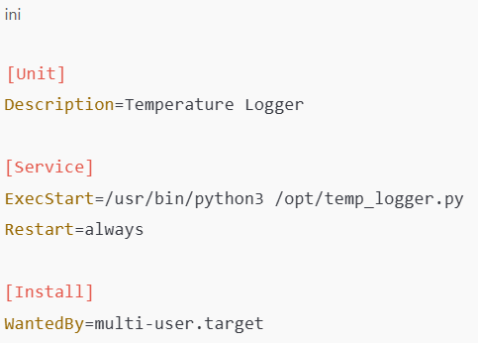
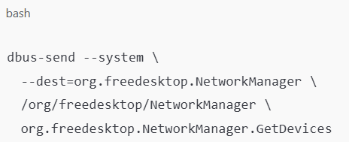
Backend Example: SystemD + DBUS

Slide 16
Frontend Interfaces: Role and Scope
Deals with user interaction: direct manipulation, monitoring, configuration.
Two main categories:
Local HMIs:
Graphical interfaces (e.g., LVGL, GTK, Qt)
Often used in kiosks, industrial panels, appliances
Remote Dashboards:
Web-based interfaces (Flask, Node.js)
Enable remote monitoring, control via HTTP/REST/WebSocket
Often built on top of backend services, using local APIs or sockets.

Slide 17
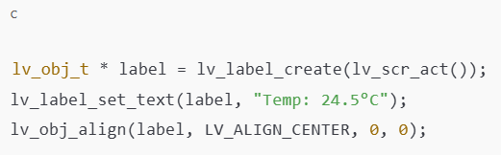
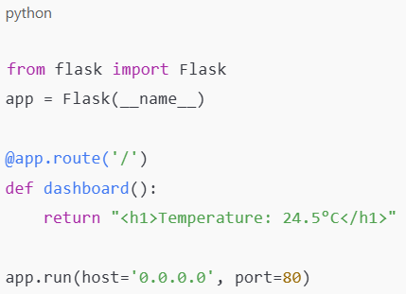
Frontend Example: LVGL + Flask

Slide 18
Integration View: From Hardware to User
Sensor
User
Driver
Daemon
REST API
Web Interface

Slide 19

Q&A / Discussion

Slide 20
Part II Linux Filesystem Organization & Shell Interaction

Slide 21
Introduction to the Linux Filesystem
Linux organizes files in a single-root hierarchical structure starting at / (root).
Unlike Windows, there are no separate drive letters (C:, D:, etc.).
Everything is mounted into this tree: disks, partitions, peripherals, pseudo-filesystems.
Unix philosophy: “Everything is a file”
Devices, processes, system information, even sockets can be accessed as files.
This unification allows for powerful, consistent, scriptable access to the system.

Slide 22
High-Level Filesystem Layout
Core folders under /:
/bin: Essential user binaries (e.g., ls, cp, cat)
/sbin: System binaries for superuser (mount, ifconfig)
/usr: Large directory tree for user applications and libraries
/lib: Shared libraries required by binaries in /bin and /sbin
/etc: Configuration files (e.g., /etc/network/interfaces)
/home: User directories (/home/student)
/var: Variable data — logs, mail, spool
/tmp: Temporary files (cleaned on reboot)
Filesystem Hierarchy Standard (FHS) defines these roles.

Slide 23
Special System Interfaces
These directories are not physical but expose dynamic kernel and device information:
/proc: Virtual files exposing system and process info (e.g., cpuinfo, meminfo, uptime)
/sys: Reflects current kernel device tree (used to configure drivers, power states, GPIOs)
/dev: Interface to device files (e.g., /dev/sda, /dev/ttyUSB0)
/mnt and /media: Mount points for USB drives, SD cards, external partitions
/run: Volatile runtime data like PID files, sockets
Key idea: These allow developers to interact with the system as if interacting with a regular file tree.

Slide 24
Part II-B CLI Exploration and Filesystem Hands-On

Slide 25
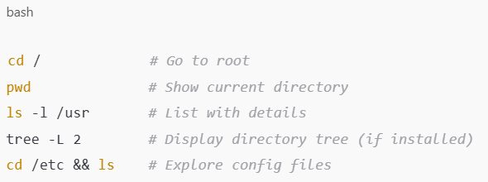
Navigation Practice
Objective: Learn to explore and move through the filesystem
Tip: Use Tab for autocompletion, cd – to go back to the previous directory.

Slide 26
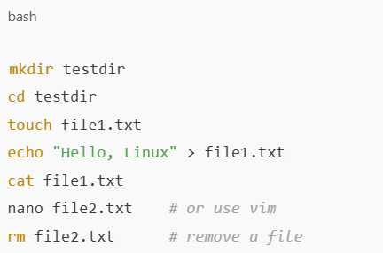
File Creation and Management from CLI
Objective: Create, edit, and inspect files from the shell
Tip: Be cautious with rm -r, especially with wildcards.

Slide 27
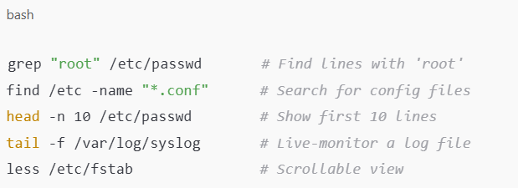
Searching and Inspecting Files
Objective: Learn to locate and read files efficiently
Tip: Use Ctrl+C to stop continuous commands like tail -f

Slide 28
Summary of CLI Tools
Category | Commands
Navigation | cd, pwd, ls, tree
File Handling | mkdir, touch, nano, vim, rm
Viewing Files | cat, les, head, tail
Text Output | echo
Searching | grep, find
System Info | df, free, uptime

Slide 29
Using man: The Manual Pages
The man is the built-in help system for Linux tools.
Tips:
Use /keyword to search inside a man page
Press q to exit
Use man -k <keyword> to find related tools (alias: apropos)
Manual sections:
1: User commands
5: File formats
8: System administration

Slide 30
Part II-C System Internals in Practice

Slide 31
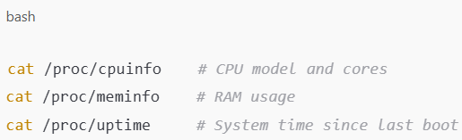
Reading System Info from /proc
/proc contains virtual files created by the kernel
Each PID has its own /proc/<pid> directory — inspect process details in real time.

Slide 32
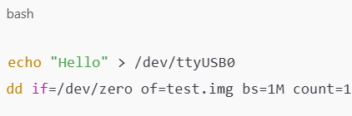
Accessing Devices via /dev
Devices are exposed as special files in /dev
Enables powerful scripting for automation and low-level testing.

Slide 33
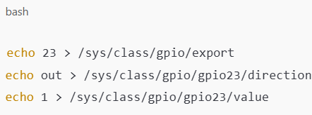
Controlling GPIO via /sys
GPIO, PWM, and other interfaces are exported under /sys/class/…
This pseudo-files allow simple scripts to manipulate hardware.

Slide 34
Why the Filesystem Matters
Linux’s "everything is a file" model promotes:
Simplicity: Unified method to access everything (files, devices, system info)
Scriptability: Use bash, Python, etc. for automation
Transparency: Inspect and debug system behavior live
This design is especially powerful in embedded systems where lightweight control is key.

Slide 35

Final Recap and Q&A
Key takeaways:
Linux separates hardware access, system behavior, and user interface through clear abstraction layers.
Its filesystem offers more than storage — it’s a control and information interface.
CLI proficiency unlocks the true potential of Linux in embedded systems.

